Slide 1
Algorithms
Chapter 3
With Question/Answer Animations
Copyright © McGraw-Hill Education. All rights reserved. No reproduction or distribution without the prior written consent of McGraw-Hill Education.

Slide 2
Chapter Summary
Algorithms
  Example Algorithms
  Algorithmic Paradigms
Growth of Functions
  Big-O and other Notation
Complexity of Algorithms

Slide 3
Algorithms
Section 3.1

Slide 4
Section Summary
Properties of Algorithms
Algorithms for Searching and Sorting
Greedy Algorithms
Halting Problem

Slide 5
Problems and Algorithms
In many domains there are key general problems that ask for output with specific properties when given valid input.
The first step is to precisely state the problem, using the appropriate structures to specify the input and the desired output.
We then solve the general problem by specifying the steps of a procedure that takes a valid input and produces the desired output. This procedure is called an algorithm.

Slide 6
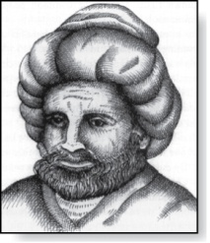
Algorithms
Abu Ja’far Mohammed Ibin Musa Al-Khowarizmi
(780-850)
Definition: An algorithm is a finite set of precise instructions for performing a computation or for solving a problem.
Example: Describe an algorithm for finding the maximum value in a finite sequence of integers.
Solution: Perform the following steps:
    Set the temporary maximum equal to the first integer in the sequence.
    Compare the next integer in the sequence to the temporary maximum.
      If it is larger than the temporary maximum, set the temporary maximum equal to this integer.
    Repeat the previous step if there are more integers. If not, stop.
    When the algorithm terminates, the temporary maximum is the largest integer in the sequence.

Slide 7
Specifying Algorithms
Algorithms can be specified in different ways. Their steps can be described in English or in pseudocode.
Pseudocode is an intermediate step between an English language description of the steps and a coding of these steps using a programming language.
It uses some of the structures found in popular languages such as C++ and Java.
Programmers can use the description of an algorithm in pseudocode to construct a program in a particular language.
Pseudocode helps us analyze the time required to solve a problem using an algorithm, independent of the actual programming language used to implement algorithm.

Slide 8
The properties of an algorithm:
Input: An algorithm has input values from a specified set.
Output: From each set of input values, an algorithm produces output values from a specified set. The output values are the solution to the problem.
Definiteness: The steps of an algorithm must be defined precisely.
Correctness: An algorithm should produce the correct output values for each set of input values.
Finiteness: An algorithm should produce the desired output after a finite number of steps for any input in the set.
Effectiveness: It must be possible to perform each step of the algorithm exactly and in a finite amount of time.
Generality: The procedure should be applicable for all problems of the desired form, not just for a particular set of input values.

Slide 9
Finding the Maximum Element in a Finite Sequence
The algorithm in pseudocode:
Does this algorithm have all the properties listed on the previous slide?
procedure max(a₁, a₂, …., a_{n}: integers)
max := a₁
for i := 2 to n
if max < a_{i} then max := a_{i}
return max{max is the largest element}

Slide 10
Some Example Algorithm Problems
Three classes of problems will be studied in this section.
  Searching Problems: finding the position of a particular element in a list.
  Sorting problems: putting the elements of a list into increasing order.
  Optimization Problems: determining the optimal value (maximum or minimum) of a particular quantity over all possible inputs.

Slide 11
Searching Problems
Definition: The general searching problem is to locate an element x in the list of distinct elements a₁,a₂,...,a_{n}, or determine that it is not in the list.
  The solution to a searching problem is the location of the term in the list that equals x (that is, i is the solution if x = a_{i}) or 0 if x is not in the list.
  For example, a library might want to check to see if a patron is on a list of those with overdue books before allowing him/her to checkout another book.
  We will study two different searching algorithms; linear search and binary search.

Slide 12
Linear Search Algorithm
The linear search algorithm locates an item in a list by examining elements in the sequence one at a time, starting at the beginning.
  First compare x with a₁. If they are equal, return the position 1.
  If not, try a₂. If x = a₂, return the position 2.
  Keep going, and if no match is found when the entire list is scanned, return 0.
procedure linear search(x:integer,
a₁, a₂, …,a_{n}: distinct integers)
i := 1
while (i ≤ n and x ≠ a_{i})
i := i + 1
if i ≤ n then location := i
else location := 0
return location{location is the subscript of the term that equals x, or is 0 if x is not found}

Slide 13
Binary Search
Assume the input is a list of items in increasing order.
The algorithm begins by comparing the element to be found with the middle element.
  If the middle element is lower, the search proceeds with the upper half of the list.
  If it is not lower, the search proceeds with the lower half of the list (through the middle position).
Repeat this process until we have a list of size 1.
  If the element we are looking for is equal to the element in the list, the position is returned.
  Otherwise, 0 is returned to indicate that the element was not found.
In Section 3.3, we show that the binary search algorithm is much more efficient than linear search.

Slide 14
Binary Search
Here is a description of the binary search algorithm in pseudocode.
procedure binary search(x: integer, a₁,a₂,…, a_{n}: increasing integers)
i := 1 {i is the left endpoint of interval}
j := n {j is right endpoint of interval}
while i < j
m := ⌊(i + j)/2⌋
if x > a_{m} then i := m + 1
else j := m
if x = a_{i} then location := i
else location := 0
return location{location is the subscript i of the term a_{i} equal to x,
or 0 if x is not found}

Slide 15
Binary Search
Example: The steps taken by a binary search for 19 in the list:
1 2 3 5 6 7 8 10 12 13 15 16 18 19 20 22
The list has 16 elements, so the midpoint is 8. The value in the 8th position is 10. Since 19 > 10, further search is restricted to positions 9 through 16.
1 2 3 5 6 7 8 10 12 13 15 16 18 19 20 22
The midpoint of the list (positions 9 through 16) is now the 12th position with a value of 16. Since 19 > 16, further search is restricted to the 13th position and above.
1 2 3 5 6 7 8 10 12 13 15 16 18 19 20 22
The midpoint of the current list is now the 14th position with a value of 19. Since 19 ≯ 19, further search is restricted to the portion from the 13th through the 14th positions .
1 2 3 5 6 7 8 10 12 13 15 16 18 19 20 22
The midpoint of the current list is now the 13th position with a value of 18. Since 19> 18, search is restricted to the portion from the 14th position through the 14th.
1 2 3 5 6 7 8 10 12 13 15 16 18 19 20 22
Now the list has a single element and the loop ends. Since 19=19, the location 14 is returned.

Slide 16
Sorting
To sort the elements of a list is to put them in increasing order (numerical order, alphabetic, and so on).
Sorting is an important problem because:
  A nontrivial percentage of all computing resources are devoted to sorting different kinds of lists, especially applications involving large databases of information that need to be presented in a particular order (e.g., by customer, part number etc.).
  An amazing number of fundamentally different algorithms have been invented for sorting. Their relative advantages and disadvantages have been studied extensively.
  Sorting algorithms are useful to illustrate the basic notions of computer science.
A variety of sorting algorithms are studied in this book; binary, insertion, bubble, selection, merge, quick, and tournament.
In Section 3.3, we’ll study the amount of time required to sort a list using the sorting algorithms covered in this section.

Slide 17
Bubble Sort
Bubble sort makes multiple passes through a list. Every pair of elements that are found to be out of order are interchanged.
procedure bubblesort(a₁,…,a_{n}: real numbers
with n ≥ 2)
for i := 1 to n− 1
for j := 1 to n − i
if a_{j} >a_{j+1} then interchange a_{j} and a_{j+1}
{a₁,…, a_{n} is now in increasing order}

Slide 18
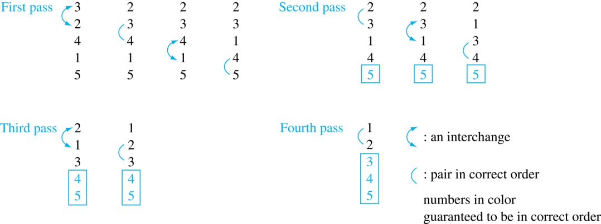
Bubble Sort
Example: Show the steps of bubble sort with 3 2 4 1 5
At the first pass the largest element has been put into the correct position
At the end of the second pass, the 2nd largest element has been put into the correct position.
In each subsequent pass, an additional element is put in the correct position.

Slide 19
Insertion Sort
Insertion sort begins with the 2nd element. It compares the 2nd element with the 1st and puts it before the first if it is not larger.
procedure insertion sort
(a₁,…,a_{n}:
real numbers with n ≥ 2)
for j := 2 to n
i := 1
while a_{j} > a_{i}
i := i + 1
m := a_{j}
for k := 0 to j − i − 1
a_{j-k} := a_{j-k-1}
a_{i} := m
{Now a₁,…,a_{n} is in increasing order}
Next the 3rd element is put into the correct position among the first 3 elements.
In each subsequent pass, the n+1st element is put into its correct position among the first n+1 elements.
Linear search is used to find the correct position.

Slide 20
Insertion Sort
Example: Show all the steps of insertion sort with the input: 3 2 4 1 5
2 3 4 1 5 (first two positions are interchanged)
2 3 4 1 5 (third element remains in its position)
1 2 3 4 5 (fourth is placed at beginning)
1 2 3 4 5 (fifth element remains in its position)

Slide 21

Greedy Algorithms
Optimization problems minimize or maximize some parameter over all possible inputs.
Among the many optimization problems we will study are:
  Finding a route between two cities with the smallest total mileage.
  Determining how to encode messages using the fewest possible bits.
  Finding the fiber links between network nodes using the least amount of fiber.
Optimization problems can often be solved using a greedy algorithm, which makes the “best” choice at each step. Making the “best choice” at each step does not necessarily produce an optimal solution to the overall problem, but in many instances, it does.
After specifying what the “best choice” at each step is, we try to prove that this approach always produces an optimal solution, or find a counterexample to show that it does not.
The greedy approach to solving problems is an example of an algorithmic paradigm, which is a general approach for designing an algorithm. We return to algorithmic paradigms in Section 3.3.

Slide 22
Greedy Scheduling
Picking the shortest talk doesn’t work.
Can you find a counterexample here?
But picking the one that ends soonest does work. The algorithm is specified on the next page.
Start: 8:00 AM
Talk 1
Start: 9:00 AM
Talk 2
Start: 9:45 AM
End :9:45 AM
Talk 3
End: 10:00 AM
End: 11:00 AM

Slide 23
Greedy Scheduling algorithm
Solution: At each step, choose the talks with the earliest ending time among the talks compatible with those selected.
Will be proven correct by induction in Chapter 5.
procedure schedule(s₁ ≤ s₂ ≤ … ≤ s_{n} : start times, e₁ ≤ e₂ ≤ … ≤ e_{n} : end times)
sort talks by finish time and reorder so that e₁ ≤ e₂ ≤ … ≤ e_{n}
S := ∅
for j := 1 to n
if talk j is compatible with S then
S := S ∅∪{talk j}
return S [ S is the set of talks scheduled]

Slide 24
Halting Problem
Example: Can we develop a procedure that takes as input a computer program along with its input and determines whether the program will eventually halt with that input.
Solution: Proof by contradiction.
Assume that there is such a procedure and call it H(P,I). The procedure H(P,I) takes as input a program P and the input I to P.
  H outputs “halt” if it is the case that P will stop when run with input I.
  Otherwise, H outputs “loops forever.”

Slide 25
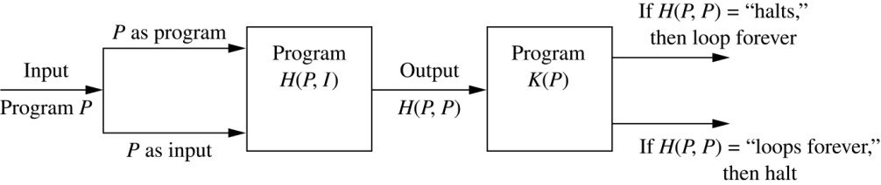
Halting Problem
Since a program is a string of characters, we can call H(P,P). Construct a procedure K(P), which works as follows.
  If H(P,P) outputs “loops forever” then K(P) halts.
  If H(P,P) outputs “halt” then K(P) goes into an infinite loop printing “ha” on each iteration.

Slide 26
Halting Problem
Now we call K with K as input, i.e. K(K).
  If the output of H(K,K) is “loops forever” then K(K) halts. A Contradiction.
  If the output of H(K,K) is “halts” then K(K) loops forever. A Contradiction.
Therefore, there can not be a procedure that can decide whether or not an arbitrary program halts. The halting problem is unsolvable.

Slide 27
The Growth of Functions
Section 3.2

Slide 28
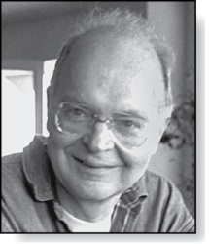
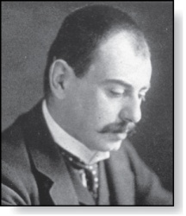
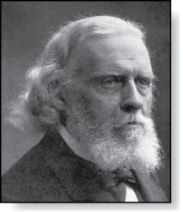
Section Summary
Donald E. Knuth
(Born 1938)
Big-O Notation
Big-O Estimates for Important Functions
Big-Omega and Big-Theta Notation
Edmund Landau
(1877-1938)
Paul Gustav Heinrich Bachmann
(1837-1920)

Slide 29
The Growth of Functions
In both computer science and in mathematics, there are many times when we care about how fast a function grows.
In computer science, we want to understand how quickly an algorithm can solve a problem as the size of the input grows.
  We can compare the efficiency of two different algorithms for solving the same problem.
  We can also determine whether it is practical to use a particular algorithm as the input grows.

Slide 30
The Growth of Functions
“Popular” functions g(n) are
n log n, 1, 2^{n}, n², n!, n, n³, log n
Listed from slowest to fastest growth:
1
log n
n
n log n
n²
n³
2^{n}
n!

Slide 31
The Growth of Functions
The growth of functions is usually described using the big-O notation.
It is a measure of the growth of functions and often used to measure the complexity of algorithms.

Slide 32
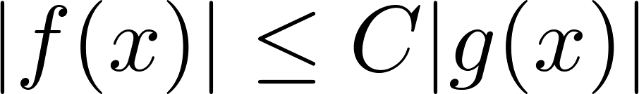
Big-O Notation
Definition: Let f and g be functions from the set of integers or the set of real numbers to the set of real numbers. We say that f(x) is O(g(x)) if there are constants C and k such that
whenever x > k.
This is read as “f(x) is big-O of g(x)” or “g asymptotically dominates f.”
The constants C and k are called witnesses to the relationship f(x) is O(g(x)). Only one pair of witnesses is needed.

Slide 33
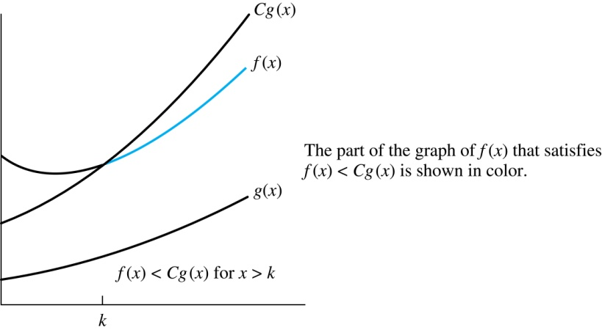
Illustration of Big-O Notation
f(x) is O(g(x)

Slide 34

Some Important Points about Big-O Notation
If one pair of witnesses is found, then there are infinitely many pairs. We can always make the k or the C larger and still maintain the inequality .
  Any pair C ̍ and k̍ where C < C̍ and k < k ̍ is also a pair of witnesses since whenever x > k̍ > k.
You may see “ f(x) = O(g(x))” instead of “ f(x) is O(g(x)).”
  But this is an abuse of the equals sign since the meaning is that there is an inequality relating the values of f and g, for sufficiently large values of x.
  It is ok to write f(x) ∊ O(g(x)), because O(g(x)) represents the set of functions that are O(g(x)).
Usually, we will drop the absolute value sign since we will always deal with functions that take on positive values.

Slide 35
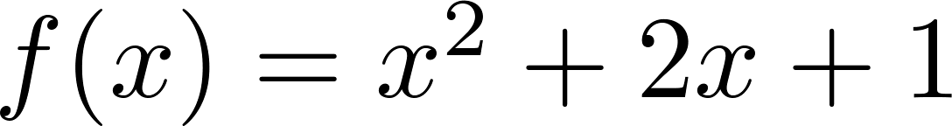
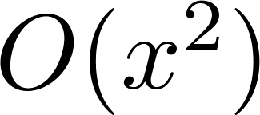
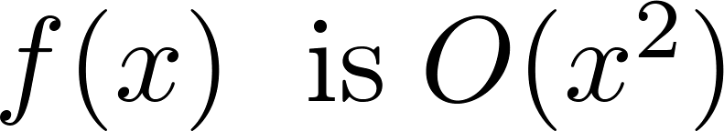
Using the Definition of Big-O Notation
Example: Show that is .
Solution: Since when x > 1, x < x² and 1 < x²
  Can take C = 4 and k = 1 as witnesses to show that
Alternatively, when x > 2, we have 2x ≤ x² and 1 < x². Hence, when x > 2.
  Can take C = 3 and k = 2 as witnesses instead.

Slide 36
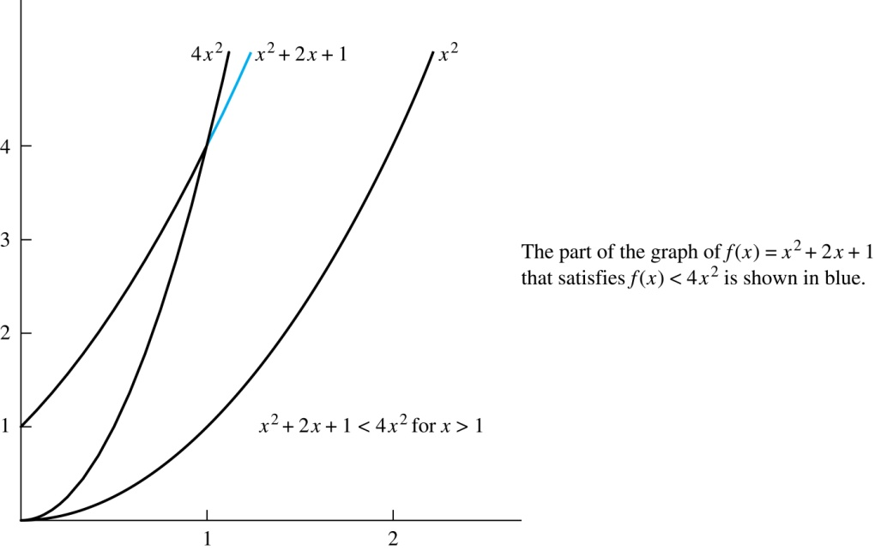
Illustration of Big-O Notation
is

Slide 37
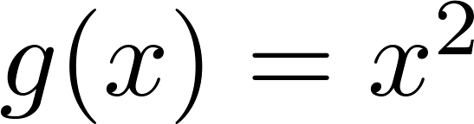
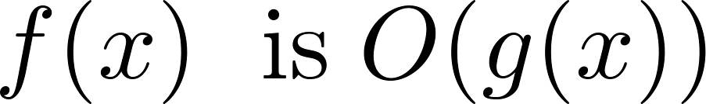

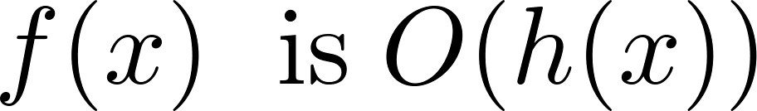
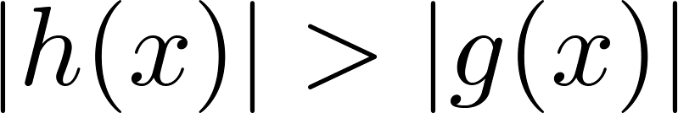
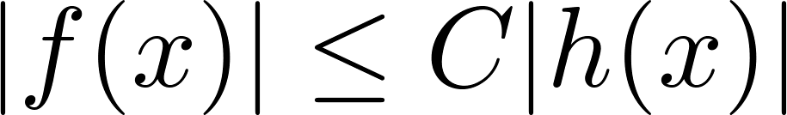
Big-O Notation
Both and
are such that and .
We say that the two functions are of the same order. (More on this later)
If and h(x) is larger than g(x) for all positive real numbers, then .
Note that if for x > k and if
for all x, then if x > k. Hence, .
For many applications, the goal is to select the function g(x) in O(g(x)) as small as possible (up to multiplication by a constant, of course).

Slide 38
Using the Definition of Big-O Notation
Example: Show that 7x² is O(x³).
Solution: When x > 7, 7x² < x³. Take C =1 and k = 7 as witnesses to establish that 7x² is O(x³).
(Would C = 7 and k = 1 work?)
Example: Show that n² is not O(n).
Solution: Suppose there are constants C and k for which n² ≤ Cn, whenever n > k. Then (by dividing both sides of n² ≤ Cn) by n, then n ≤ C must hold for all n > k. A contradiction!

Slide 39

Big-O Estimates for Polynomials
Example: Let
where are real numbers with a_{n} ≠0.
Then f(x) is O(x^{n}).
Proof: |f(x)| = |a_{n}x^{n} + a_{n-1} x^{n-1} + ∙∙∙ + a₁x¹ + a₀|
≤ |a_{n}|x^{n} + |a_{n-1}| x^{n-1} + ∙∙∙ + |a₁|x¹ + |a₀|
= x^{n} (|a_{n}| + |a_{n-1}| /x + ∙∙∙ + |a₁|/x^{n-1} + |a₀|/ x^{n})
≤ x^{n} (|a_{n}| + |a_{n-1}| + ∙∙∙ + |a₁|+ |a₀|)
Take C = |a_{n}| + |a_{n-1}| + ∙∙∙ + |a₀| and k = 1. Then f(x) is O(x^{n}).
The leading term a_{n}x^{n} of a polynomial dominates its growth. [ For any polynomial of degree n, f(x) is O(x^{n}). ]
Uses triangle inequality, an exercise in Section 1.8.
Assuming x > 1

Slide 40
Big-O Estimates for some Important Functions
Example: Use big-O notation to estimate the sum of the first n positive integers.
Solution:
Example: Use big-O notation to estimate the factorial function
Solution:
Continued →

Slide 41
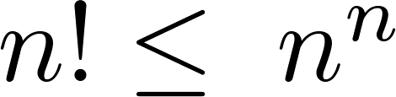
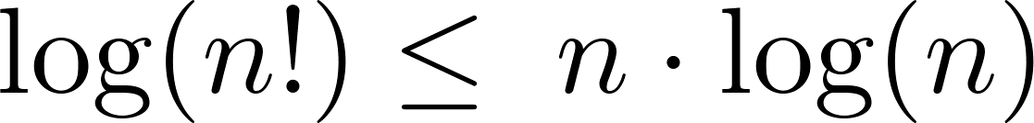
Big-O Estimates for some Important Functions
Example: Use big-O notation to estimate log n!
Solution: Given that (previous slide)
then .
Hence, log(n!) is O(n∙log(n)) taking C = 1 and k = 1.

Slide 42
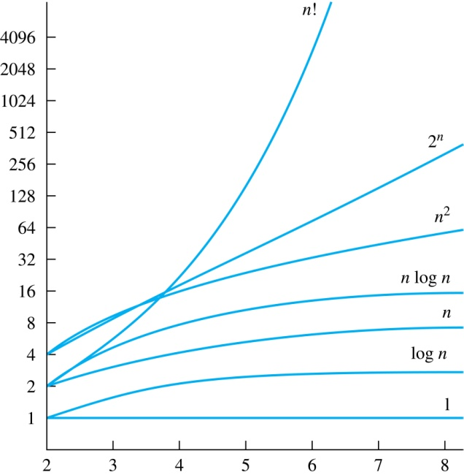
Display of Growth of Functions
The difference in behavior of functions as n gets larger

Slide 43
Useful Big-O Estimates Involving Logarithms, Powers, and Exponents
If d > c > 1, then
n^{c} is O(n^{d}), but n^{d} is not O(n^{c}).
If b > 1 and c and d are positive, then
(log_{b} n)^{c} is O(n^{d}), but n^{d} is not O((log_{b} n)^{c}).
If b > 1 and d is positive, then
n^{d} is O(b^{n}), but b^{n} is not O(n^{d}).
If c > b > 1, then
b^{n} is O(c^{n}), but c^{n} is not O(b^{n}).

Slide 44
Combinations of Functions
If f₁ (x) is O(g₁(x)) and f₂ (x) is O(g₂(x)) then
( f₁ + f₂ )(x) is O(max(|g₁(x) |,|g₂(x) |)).
If f₁ (x) and f₂ (x) are both O(g(x)) then
( f₁ + f₂ )(x) is O(g(x)).
  If f₁ (x) is O(g₁(x)) and f₂ (x) is O(g₂(x)) then
( f₁ f₂ )(x) is O(g₁(x)g₂(x)).

Slide 45
Combinations of Functions
If f₁ (x) is O(g₁(x)) and f₂ (x) is O(g₂(x)) then
( f₁ + f₂ )(x) is O(max(|g₁(x) |,|g₂(x) |)).
  By the definition of big-O notation, there are constants C₁,C₂ ,k₁,k₂ such that | f₁ (x) ≤ C₁|g₁(x) | when x > k₁ and f₂ (x) ≤ C₂|g₂(x) | when x > k₂ .
  |( f₁ + f₂ )(x)| = |f₁(x) + f₂(x)|
≤ |f₁ (x)| + |f₂ (x)| by the triangle inequality |a + b| ≤ |a| + |b|
  |f₁ (x)| + |f₂ (x)| ≤ C₁|g₁(x) | + C₂|g₂(x) |
≤ C₁|g(x) | + C₂|g(x) | where g(x) = max(|g₁(x)|,|g₂(x)|)
= (C₁ + C₂) |g(x)|
= C|g(x)| where C = C₁ + C₂
  Therefore |( f₁ + f₂ )(x)| ≤ C|g(x)| whenever x > k, where k = max(k₁,k₂).

Slide 46
Ordering Functions by Order of Growth
Put the functions below in order so that each function is big-O of the next function on the list.
f₁(n) = (1.5)^{n}
f₂(n) = 8n³+17n² +111
f₃(n) = (log n )²
f₄(n) = 2^{n}
f₅(n) = log (log n)
f₆(n) = n² (log n)³
f₇(n) = 2^{n} (n² +1)
f₈(n) = n³+ n(log n)²
f₉(n) = 10000
f₁₀(n) = n!
We solve this exercise by successively finding the function that grows slowest among all those left on the list.
f₉(n) = 10000 (constant, does not increase with n)
f₅(n) = log (log n) (grows slowest of all the others)
f₃(n) = (log n )² (grows next slowest)
f₆(n) = n² (log n)³ (next largest, (log n)³ factor smaller than any power of n)
f₂(n) = 8n³+17n² +111 (tied with the one below)
f₈(n) = n³+ n(log n)² (tied with the one above)
f₁(n) = (1.5)^{n} (next largest, an exponential function)
f₄(n) = 2^{n} (grows faster than one above since 2 > 1.5)
f₇(n) = 2^{n} (n² +1) (grows faster than above because of the n² +1 factor)
f₁₀(n) = n! ( n! grows faster than c^{n} for every c)

Slide 47
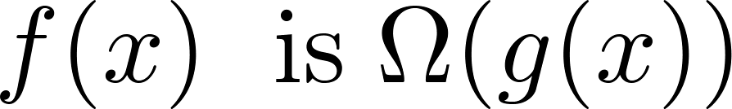
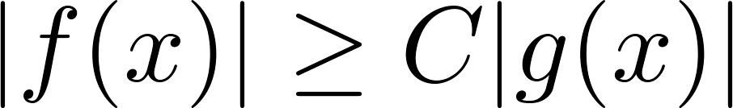
Big-Omega Notation
Definition: Let f and g be functions from the set of integers or the set of real numbers to the set of real numbers. We say that
if there are constants C and k such that
when x > k.
We say that “f(x) is big-Omega of g(x).”
Big-O gives an upper bound on the growth of a function, while Big-Omega gives a lower bound. Big-Omega tells us that a function grows at least as fast as another.
f(x) is Ω(g(x)) if and only if g(x) is O(f(x)).
Ω is the upper case version of the lower case Greek letter ω.

Slide 48
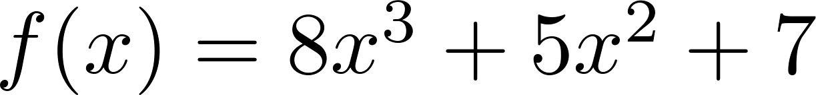
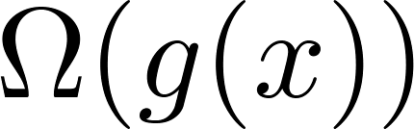
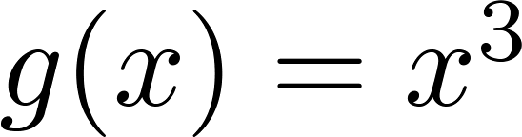
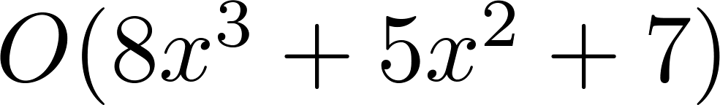
Big-Omega Notation
Example: Show that is
where .
Solution: for all positive real numbers x.
  Is it also the case that is ?

Slide 49
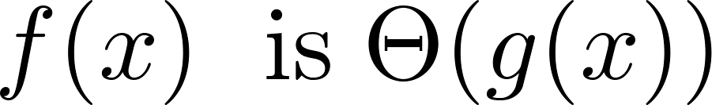
Big-Theta Notation
Θ is the upper case version of the lower case Greek letter θ.
Definition: Let f and g be functions from the set of integers or the set of real numbers to the set of real numbers. The function if
and .
We say that “f is big-Theta of g(x)” and also that “f(x) is of order g(x)” and also that “f(x) and g(x) are of the same order.”
if and only if there exists constants C₁ , C₂ and k such that C₁g(x) < f(x) < C₂ g(x) if x > k. This follows from the definitions of big-O and big-Omega.

Slide 50
Big Theta Notation
Example: Show that the sum of the first n positive integers is Θ(n²).
Solution: Let f(n) = 1 + 2 + ∙∙∙ + n.
  We have already shown that f(n) is O(n²).
  To show that f(n) is Ω(n²), we need a positive constant C such that f(n) > Cn² for sufficiently large n. Summing only the terms greater than n/2 we obtain the inequality
  1 + 2 + ∙∙∙ + n ≥ ⌈ n/2⌉ + (⌈ n/2⌉ + 1) + ∙∙∙ + n
  ≥ ⌈ n/2⌉ + ⌈ n/2⌉ + ∙∙∙ + ⌈ n/2⌉
  = (n − ⌈ n/2⌉ + 1 ) ⌈ n/2⌉
  ≥ (n/2)(n/2) = n²/4
  Taking C = ¼, f(n) > Cn² for all positive integers n. Hence, f(n) is Ω(n²), and we can conclude that f(n) is Θ(n²).

Slide 51
Big-Theta Notation
Example: Sh0w that f(x) = 3x² + 8x log x is Θ(x²).
Solution:
    3x² + 8x log x ≤ 11x² for x > 1, since 0 ≤ 8x log x ≤ 8x² .
      Hence, 3x² + 8x log x is O(x²).
    x² is clearly O(3x² + 8x log x)
    Hence, 3x² + 8x log x is Θ(x²).

Slide 52
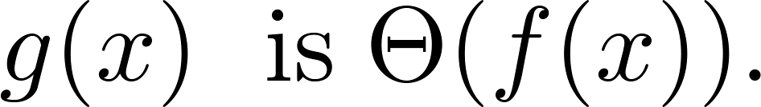
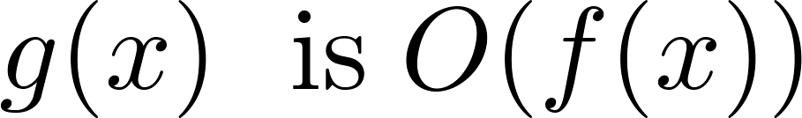
Big-Theta Notation
When it must also be the case that
Note that if and only if it is the case that and .

Slide 53
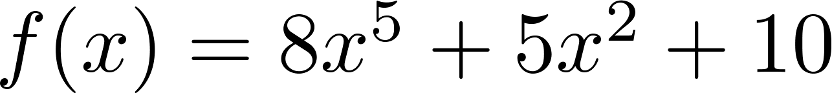
Big-Theta Estimates for Polynomials
Theorem: Let
where are real numbers with a_{n} ≠0.
Then f(x) is of order x^{n} (or Θ(x^{n})).
(The proof is an exercise.)
Example:
The polynomial is order of x⁵ (or Θ(x⁵)).
The polynomial is order of x¹⁹⁹ (or Θ(x¹⁹⁹) ).

Slide 54
Complexity of Algorithms
Section 3.3

Slide 55
Section Summary
Time Complexity
Worst-Case Complexity
Algorithmic Paradigms
Understanding the Complexity of Algorithms

Slide 56
The Complexity of Algorithms
Given an algorithm, how efficient is this algorithm for solving a problem given input of a particular size? To answer this question, we ask:
  How much time does this algorithm use to solve a problem?
  How much computer memory does this algorithm use to solve a problem?
When we analyze the time the algorithm uses to solve the problem given input of a particular size, we are studying the time complexity of the algorithm.
When we analyze the computer memory the algorithm uses to solve the problem given input of a particular size, we are studying the space complexity of the algorithm.

Slide 57
The Complexity of Algorithms
The time complexity of an algorithm is the time required to run an algorithm. It is usually measured in terms of the number of operations used by an algorithm and expressed in big-O notation.
We will measure time complexity in terms of the number of operations an algorithm uses and we will use big-O and big-Theta notation to estimate the time complexity.
We can use this analysis to see whether it is practical to use this algorithm to solve problems with input of a particular size. We can also compare the efficiency of different algorithms for solving the same problem.
We ignore implementation details (including the data structures used and both the hardware and software platforms) because it is extremely complicated to consider them.

Slide 58
Time Complexity
To analyze the time complexity of algorithms, we determine the number of operations, such as comparisons and arithmetic operations (addition, multiplication, etc.). We can estimate the time a computer may actually use to solve a problem using the amount of time required to do basic operations.
We will focus on the worst-case time complexity of an algorithm. This provides an upper bound on the number of operations an algorithm uses to solve a problem with input of a particular size.
This is the average number of operations an algorithm uses to solve a problem over all inputs of a particular size. It is usually much more difficult to determine the average case time complexity of an algorithm.

Slide 59
Complexity Analysis of Algorithms
Example: Describe the time complexity of the algorithm for finding the maximum element in a finite sequence.
procedure max(a₁, a₂, …., a_{n}: integers)
max := a₁
for i := 2 to n
if max < a_{i} then max := a_{i}
return max{max is the largest element}
Solution: Count the number of comparisons.
  The max < a_{i} comparison is made n − 1 times.
  Each time i is incremented, a test is made to see if i ≤ n.
  One last comparison determines that i > n.
  Exactly 2(n − 1) + 1 = 2n − 1 comparisons are made.
Hence, the time complexity of the algorithm is Θ(n).

Slide 60
Worst-Case Complexity of Linear Search
Example: Determine the time complexity of the linear search algorithm.
procedure linear search(x:integer,
a₁, a₂, …,a_{n}: distinct integers)
i := 1
while (i ≤ n and x ≠ a_{i})
i := i + 1
if i ≤ n then location := i
else location := 0
return location{location is the subscript of the term that equals x, or is 0 if x is not found}
Solution: Count the number of comparisons.
  At each step two comparisons are made; i ≤ n and x ≠ a_{i} .
  To end the loop, one comparison i ≤ n is made.
  After the loop, one more i ≤ n comparison is made.
If x = a_{i} , 2i + 1 comparisons are used. If x is not on the list, 2n + 1 comparisons are made and then an additional comparison is used to exit the loop. So, in the worst case 2n + 2 comparisons are made. Hence, the complexity is Θ(n).

Slide 61
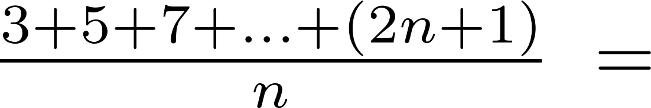
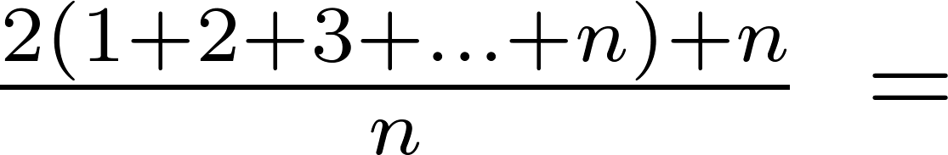
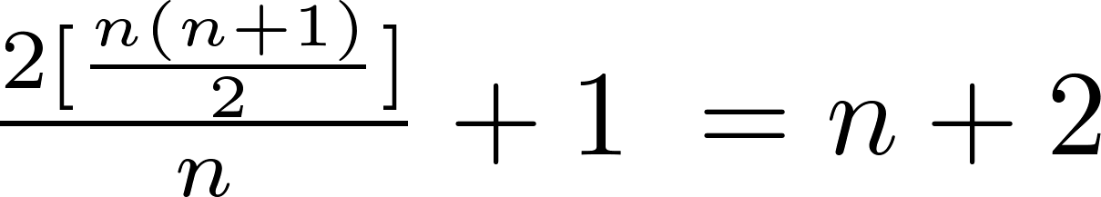
Average-Case Complexity of Linear Search
Example: Describe the average case performance of the linear search algorithm. (Although usually it is very difficult to determine average-case complexity, it is easy for linear search.)
Solution: Assume the element is in the list and that the possible positions are equally likely. By the argument on the previous slide, if x = a_{i} , the number of comparisons is 2i + 1.
Hence, the average-case complexity of linear search is Θ(n).

Slide 62
Worst-Case Complexity of Binary Search
Example: Describe the time complexity of binary search in terms of the number of comparisons used.
procedure binary search(x: integer, a₁,a₂,…, a_{n}: increasing integers)
i := 1 {i is the left endpoint of interval}
j := n {j is right endpoint of interval}
while i < j
m := ⌊(i + j)/2⌋
if x > a_{m} then i := m + 1
else j := m
if x = a_{i} then location := i
else location := 0
return location{location is the subscript i of the term a_{i} equal to x, or 0 if x is not found}
Solution: Assume (for simplicity) n = 2^{k} elements. Note that k = log n.
  Two comparisons are made at each stage; i < j, and x > a_{m} .
  At the first iteration the size of the list is 2^{k} and after the first iteration it is 2^{k-1}. Then 2^{k-2} and so on until the size of the list is 2¹ = 2.
  At the last step, a comparison tells us that the size of the list is the size is 2⁰ = 1 and the element is compared with the single remaining element.
  Hence, at most 2k + 2 = 2 log n + 2 comparisons are made.
  Therefore, the time complexity is Θ (log n), better than linear search.

Slide 63
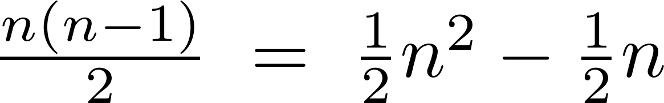
Worst-Case Complexity of Bubble Sort
Example: What is the worst-case complexity of bubble sort in terms of the number of comparisons made?
procedure bubblesort(a₁,…,a_{n}: real numbers
with n ≥ 2)
for i := 1 to n− 1
for j := 1 to n − i
if a_{j} >a_{j+1} then interchange a_{j} and a_{j+1}
{a₁,…, a_{n} is now in increasing order}
Solution: A sequence of n−1 passes is made through the list. On each pass n − i comparisons are made.
The worst-case complexity of bubble sort is Θ(n²) since .

Slide 64
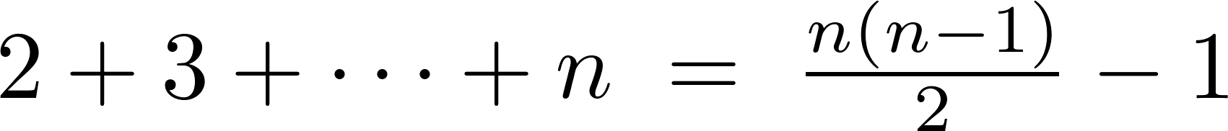
Worst-Case Complexity of Insertion Sort
Example: What is the worst-case complexity of insertion sort in terms of the number of comparisons made?
procedure insertion sort(a₁,…,a_{n}:
real numbers with n ≥ 2)
for j := 2 to n
i := 1
while a_{j} > a_{i}
i := i + 1
m := a_{j}
for k := 0 to j − i − 1
a_{j-k} := a_{j-k-1}
a_{i} := m
Solution: The total number of comparisons are:
Therefore the complexity is Θ(n²).

Slide 65

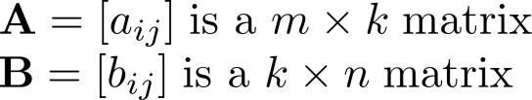
Matrix Multiplication Algorithm
The definition for matrix multiplication can be expressed as an algorithm; C = A B where C is an m n matrix that is the product of the m k matrix A and the k n matrix B.
This algorithm carries out matrix multiplication based on its definition.
procedure matrix multiplication(A,B: matrices)
for i := 1 to m
for j := 1 to n
c_{ij} := 0
for q := 1 to k
c_{ij} := c_{ij} + a_{iq} b_{qj}
return C{C = [c_{ij}] is the product of A and B}

Slide 66
Complexity of Matrix Multiplication
Example: How many additions of integers and multiplications of integers are used by the matrix multiplication algorithm to multiply two n n matrices.
Solution: There are n² entries in the product. Finding each entry requires n multiplications and n − 1 additions. Hence, n³ multiplications and n²(n − 1) additions are used.
Hence, the complexity of matrix multiplication is O(n³).

Slide 67
Boolean Product Algorithm
The definition of Boolean product of zero-one matrices can also be converted to an algorithm.
procedure Boolean product(A,B: zero-one matrices)
for i := 1 to m
for j := 1 to n
c_{ij} := 0
for q := 1 to k
c_{ij} := c_{ij} ∨ (a_{iq} ∧ b_{qj})
return C{C = [c_{ij}] is the Boolean product of A and B}

Slide 68
Complexity of Boolean Product Algorithm
Example: How many bit operations are used to find A ⊙ B, where A and B are n n zero-one matrices?
Solution: There are n² entries in the A ⊙ B. A total of n Ors and n ANDs are used to find each entry. Hence, each entry takes 2n bit operations. A total of 2n³ operations are used.
Therefore the complexity is O(n³)

Slide 69
Matrix-Chain Multiplication
How should the matrix-chain A₁A₂∙ ∙ ∙A_{n} be computed using the fewest multiplications of integers, where A₁ , A₂ , ∙ ∙ ∙ , A_{n} are m₁ m₂, m₂ m₃ , ∙ ∙ ∙ m_{n} m_{n+1} integer matrices. Matrix multiplication is associative (exercise in Section 2.6).
Example: In which order should the integer matrices A₁A₂A₃ - where A₁ is 30 20 , A₂ 20 40, A₃ 40 10 - be multiplied to use the least number of multiplications.
Solution: There are two possible ways to compute A₁A₂A₃.
  A₁(A₂A₃): A₂A₃ takes 20 ∙ 40 ∙ 10 = 8000 multiplications. Then multiplying A₁ by the 20 10 matrix A₂A₃ takes 30 ∙ 20 ∙ 10 = 6000 multiplications. So the total number is 8000 + 6000 = 14,000.
  (A₁A₂)A₃: A₁A₂ takes 30 ∙ 20 ∙ 40 = 24,000 multiplications. Then multiplying the 30 40 matrix A₁A₂ by A₃ takes 30 ∙ 40 ∙ 10 = 12,000 multiplications. So the total number is 24,000 + 12,000 = 36,000.
So the first method is best.
An efficient algorithm for finding the best order for matrix-chain multiplication can be based on the algorithmic paradigm known as dynamic programming. (see Ex. 57 in Section 8.1)

Slide 70
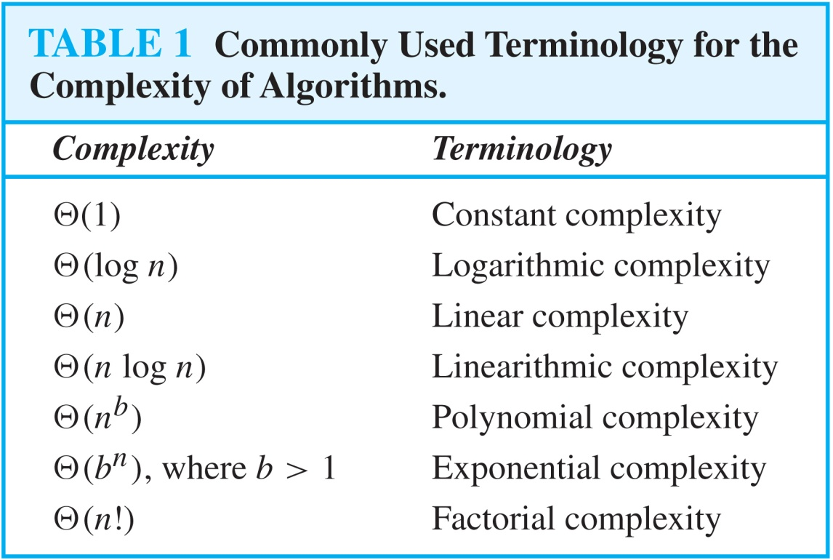
Understanding the Complexity of Algorithms

Slide 71
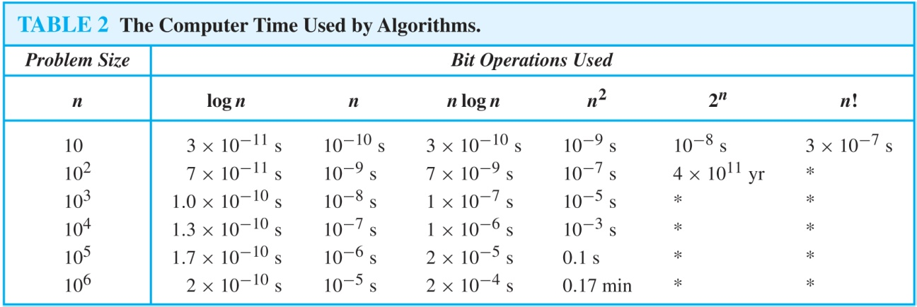
Understanding the Complexity of Algorithms
Times of more than 10¹⁰⁰ years are indicated with an *.

Slide 72
Complexity of Problems
Tractable Problem
Intractable Problem
Unsolvable Problem
Class P
Class NP
NP Complete Class

Slide 73
Complexity of Problems
Tractable Problem: A problem that is solvable by a polynomial-time algorithm. The upper bound is polynomial.
  A problem is called tractable iff there is an efficient algorithm that can be solved by a polynomial-time algorithm.
  Examples:
    Searching an unordered list,
    searching an ordered list,
    sorting a list,
    Multiplication of integers, and
    Finding a minimum spanning tree in a graph.

Slide 74
Complexity of Problems
Intractable Problem:
A problem that cannot be solved by a polynomial-time algorithm. The lower bound is exponential.
  A problem is called intractable iff there is no efficient algorithm and that cannot be solved by a polynomial-time algorithm.
  Examples: Towers of Hanoi

Slide 75
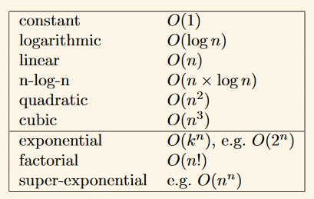
Tractable vs Intractable

Slide 76
Complexity of Problems
Unsolvable Problem : No algorithm exists to solve this problem, e.g., halting problem.
Class P:
  P : polynomial time by deterministic Machine
  A language L is in class P if there is some polynomial T(n) such that L = L(M) for some deterministic machine M of time complexity T(n).
  Example: Kruskals Algorithm

Slide 77
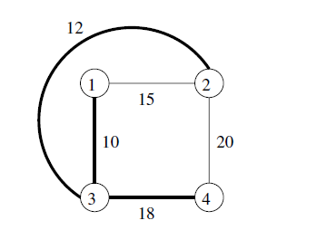
Kruskals Algorithm
Finding a minimum weight spanning tree for a graph.

Slide 78
Complexity of Problems
Class NP (Nondeterministic Polynomial Time):
  Solution can be checked in polynomial time. But no polynomial time algorithm has been found for finding a solution to problems in this class.
  Example: The Traveling Salesman Problem
NP Complete Class: If you find a polynomial time algorithm for one member of the class, it can be used to solve all the problems in the class.
  Examples:
    Satisfiability (SAT) problem
    Vertex cover problem
    Zero-one Knapsack problem

